Slide 1
More Methods

Slide 2
Part 1: Parameters
Now that the kangaroo and the turtle have raced, let's make a method for the kangaroo to hop back to the turtle and challenge him to a race again.
Click on the kangaroo, create new method, and name it 'challenge'. Drag a 'do in order' into your method.
Then, click on kangaroo in the object area, drag it into the method and select the method 'turn to face' - select the turtle - the entire turtle.
See the screenshot on the next slide for an illustration

Slide 3
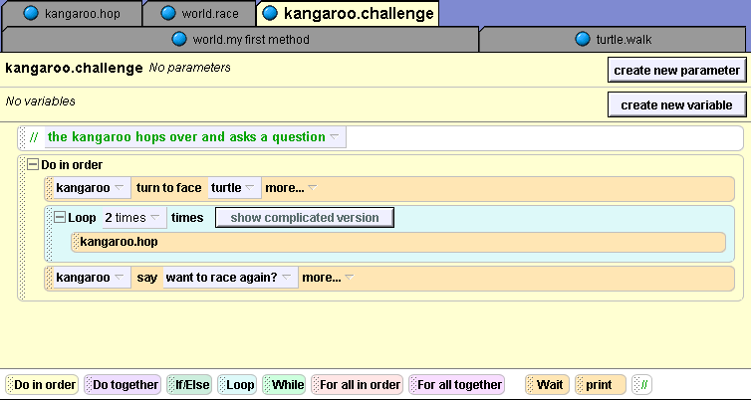

Slide 4
Why use parameters
If we save the kangaroo and put it in a world where there is no turtle, what will happen? Alice will crash because the method kangaroo.challenge refers to a non-existent object. A class-level method should not have any references to other characters or world-level methods.
In other words, instead of referring to the turtle in the first instruction of this method, we're going to use a parameter. A parameter is a place holder.

Slide 5
An example scenario
For example, in another world, you may want your kangaroo to be able to challenge a turtle or a bunny or a penguin. We could write three different methods: one for the kangaroo to challenge the turtle, another for the kangaroo to challenge the bunny and a separate one for the kangaroo to challenge the penguin.

Slide 6
How to create a parameter
In this case, a parameter is going to be a placeholder for an object that the kangaroo will challenge - such as a bunny, a penguin or a turtle.
Click on 'create new parameter' and name it 'obj'. Before you click okay, make sure you select the type 'object‘
See the screenshot on the next slide for an illustration

Slide 7
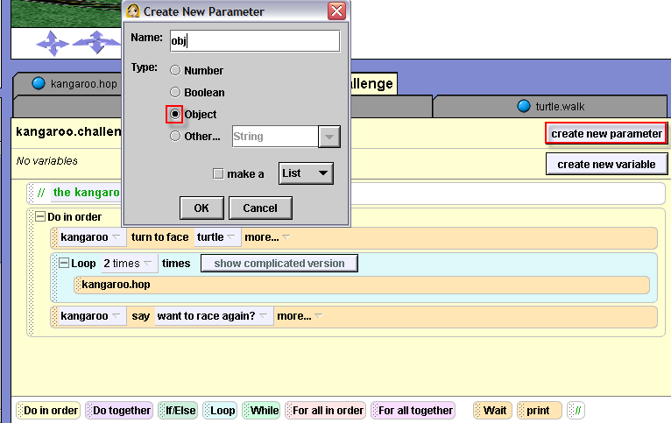

Slide 8
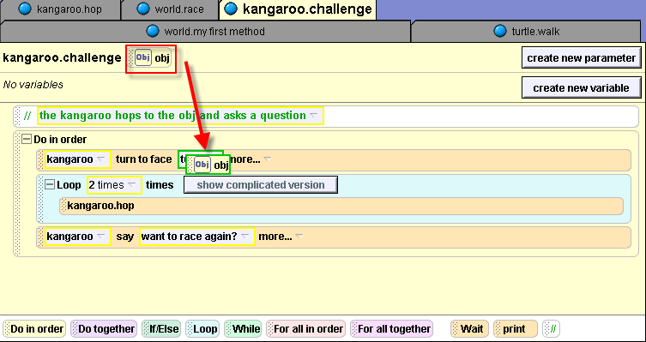
Now, you can see that the 'obj' parameter has appeared beside the name of the method. I've highlighted it with a red box. Drag 'obj' into the method to replace 'turtle'.

Slide 9
How to call a method that has a parameter
To test your code, drag kangaroo.challenge into world.myfirstmethod underneath the world.race method that is already there.
When you drag kangaroo.challenge into the method, once you release your mouse you will have to select turtle, then entire turtle as the obj to replace parameter.

Slide 10
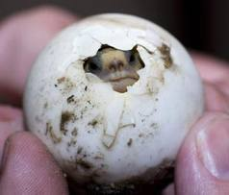
Testing kangaroo.challenge on another object
To reinforce your understanding of parameters, let's call the method on another object. Add the tortoise (from the Animal folder) to your world by clicking on the Add objects button.
Drag kangaroo.challenge into your world.myfirstmethod and select the tortoise as the parameter.

Slide 11
Testing kangaroo.challenge (cont 1)
Depending on where you placed the tortoise in your world, you may notice that having the kangaroo hop twice toward him does not look very good. Once you know how to use the built in function 'distance to' you can improve the appearance of this method. For now, don't worry about it.
Let's finish making the rest of our world. In world.myfirstmethod, delete the second call to kangaroo.challenge for the tortoise. If you want, you can delete the entire tortoise from your world.

Slide 12
Part 2: Properties
Finally, we want to write a method to make the turtle go into his shell. Click on turtle in the object tree. Click on the method tab and create a new method named 'hide'
We are going to make all of the turtle's body parts invisible at the same time, except for his shell.
To do this, first drag a 'do together' into the 'hide' method.

Slide 13
Creating the turtle.hide method
Then, click on the + beside turtle in the object tree. Click on the 'backRightLeg'.
In the details area: Click on the properties tab. Click on 'isShowing' and drag it into the 'do together.'
Set the value to false. Click on the 'more' and set duration to 0.1

Slide 14
Turtle.hide method (cont 1)
Do the same thing for each of the body parts by clicking on each of these in the object tree- backLeftLeg, frontLeftLeg, frontRightLeg, tail and head - and dragging the isShowing property of each into the turtle.hide method.

Slide 15
Turtle.hide (cont 3)
Now drag the turtle.hide method into your world.myfirstmethod underneath kangaroo.challenge.
If you want, you can have the kangaroo say something at the end.

Slide 16
Recap
If you want to write a method in which an object interacts with another character, you can either write a world-level method or write a class-level method with parameters
A class-level method with parameters is a good choice if you want to be able to save your object out so that it can perform your new method in different worlds.

Slide 17
Recap continued
Keep in mind that parameters are not only used in class-level methods. For example, if you have five characters in your world and you want them to all flip together, you can write one world level method with an object parameter that flips. Then in a do together, call the method for each of the objects in your world.
You can change certain properties of an object while you're writing a method

